Slide 1

Introduction to AI and its history
AI

Slide 2
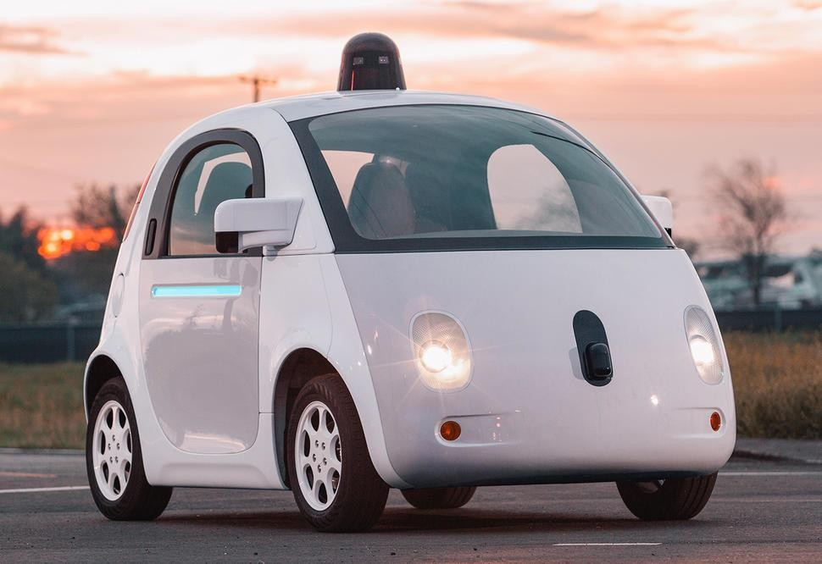
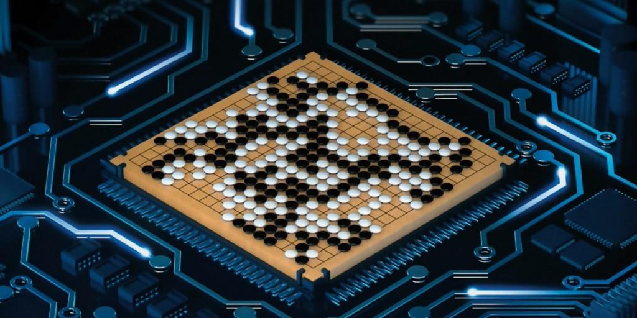


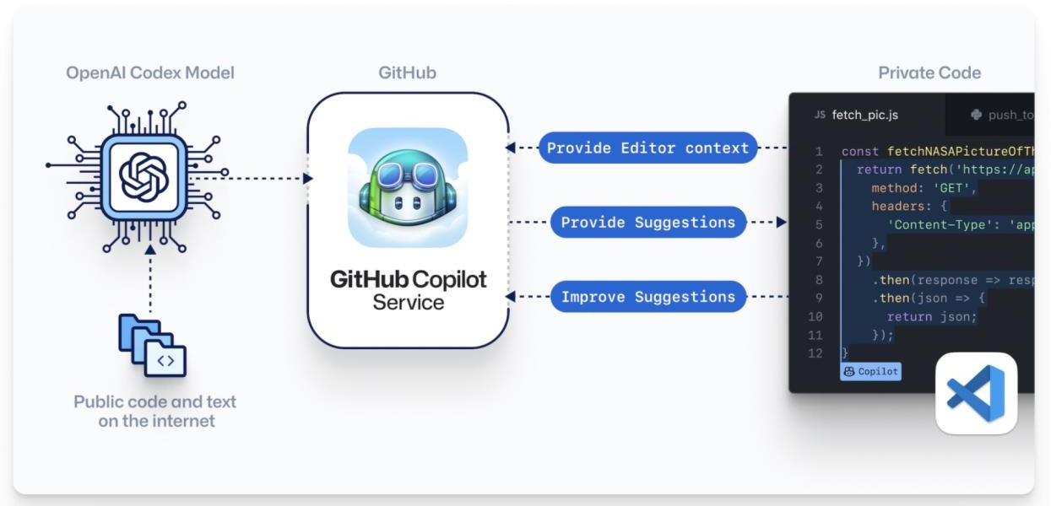

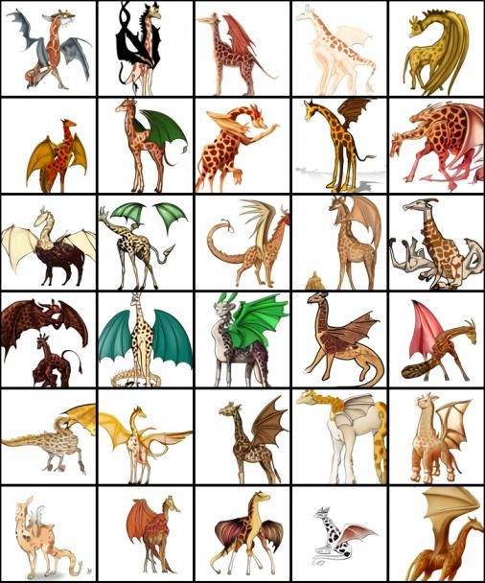


Slide 3

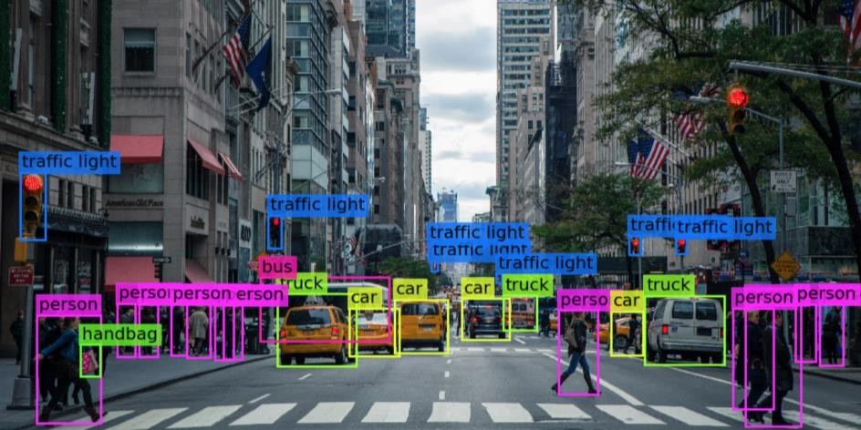
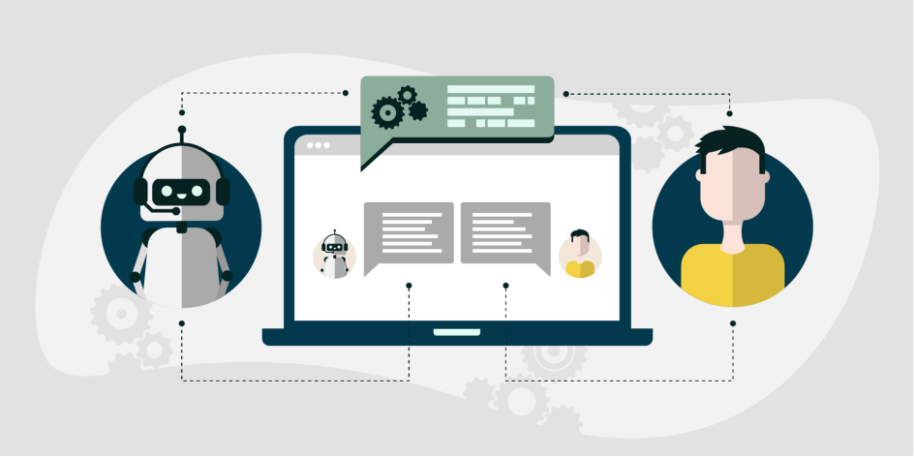
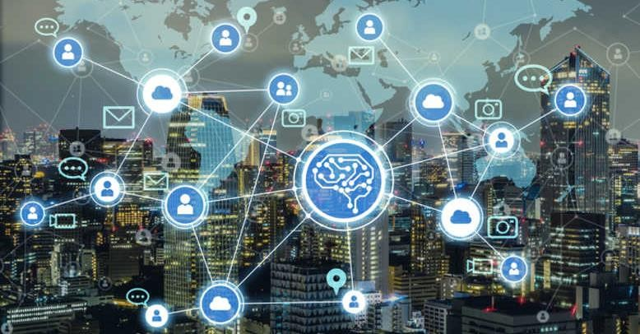


Applications of AI
Computer Vision
Voice Recognition
Natural Language Processing
Large Scale Data Analysis

Slide 4
Artificial Intelligence – What is it? – Definitions
“Artificial Intelligence is the science and engineering of making intelligent machines, especially intelligent computer programs.”
- John McCarthy, Stanford
“Artificial intelligence (AI) refers to systems that display intelligent behaviour by analysing their environment and taking actions – with some degree of autonomy – to achieve specific goals.”
- EU Communication 25 April 2018
“the scientific understanding of the mechanisms underlying thought and intelligent behavior and their embodiment in machines.”
- AAAI

Slide 5
What is intelligence?
Legg and Hutter made a survey of 71 different definitions of intelligence in 2007.
Commonly occurring features:
Is a property that an individual agent has as it interacts with its
environment or environments.
Is related to the agent’s ability to succeed or profit with respect to
some goal or objective.
Depends on how able the agent is to adapt to different objectives and
environments
Based on this, they came up with: “Intelligence measures an agent’s ability to achieve goals in a wide range of environments.”
https://arxiv.org/pdf/0706.3639.pdf%20a%20collection%20of%
20definitions%20of%20intelligence

Slide 6
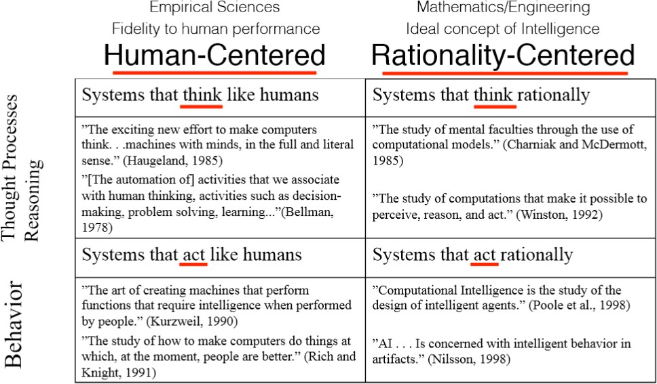
Artificial Intelligence – Four Views

Slide 7



Artificial Intelligence – The Intelligent Agent Paradigm
Intelligent agent (AI-agent)
Goal
Observe
Environment
Agent
Influence
Computer program or physical robot
A city, a mine,
the stock market, the web, …
Intelligent capabilities through integration of AI techniques

Slide 8
From Peter Norvig, Google
Computer Science:
Doing the right thing, efficiently, when you can define what that means in advance.
Artificial intelligence:
Doing the right thing, efficiently, when you don’t know what
that means in advance.
Shifting from design-time to run-time.

Slide 9





Artificial Intelligence (AI)
Machine Learning (ML)
Deep Learning (DL)

Slide 10























Slide 11
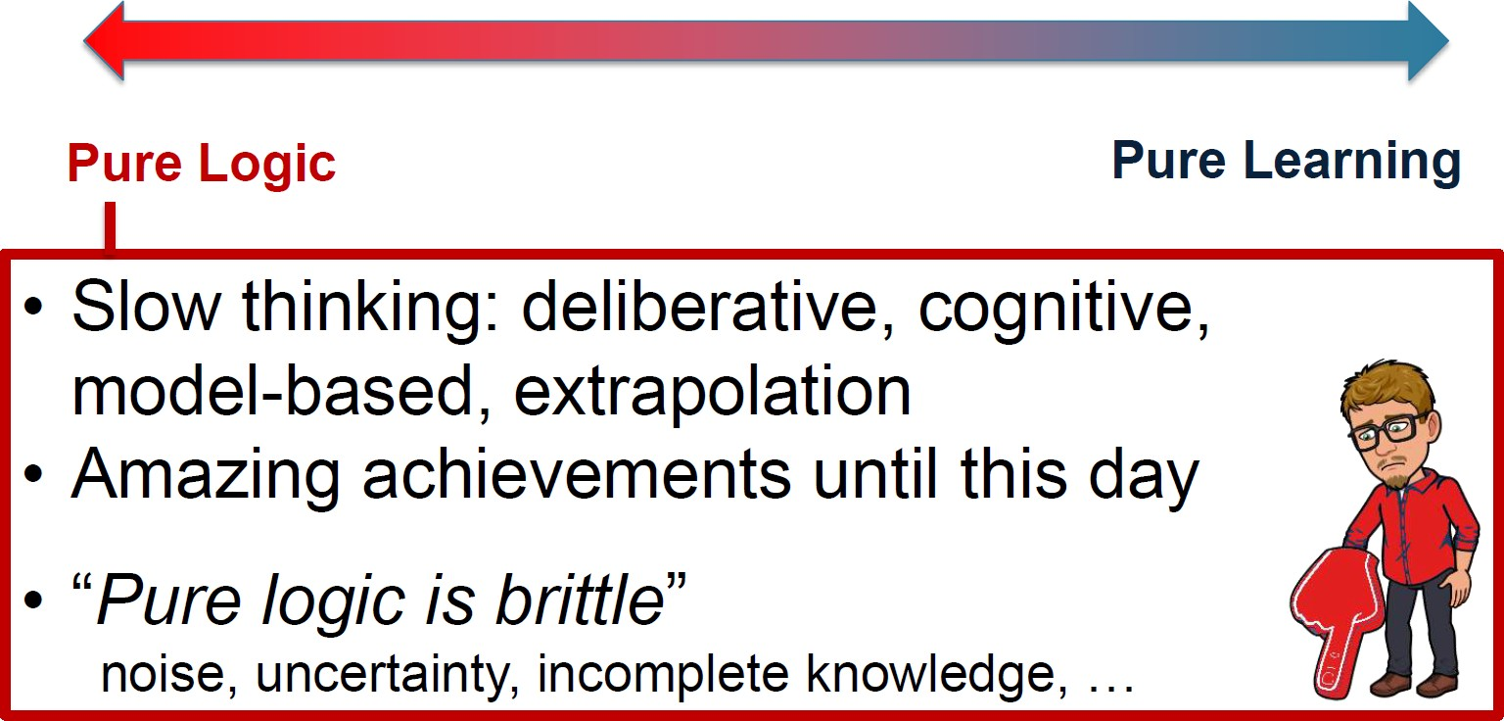
https://web.cs.ucla.edu/~guyvdb/slides/ComputersAndThought.pdf

Slide 12
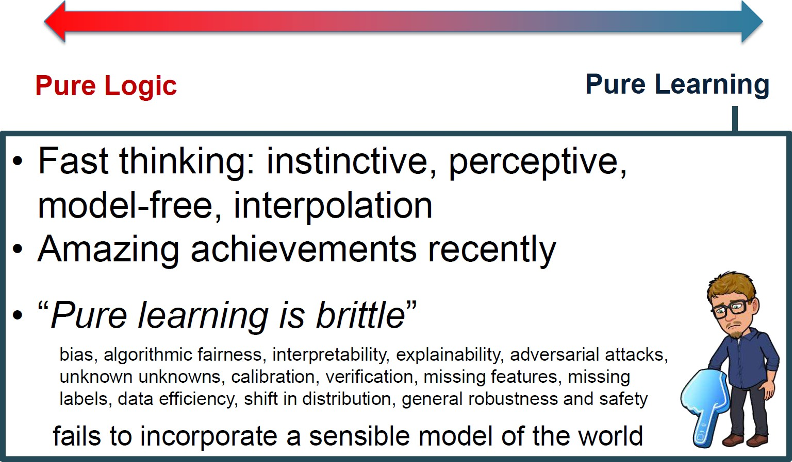
https://web.cs.ucla.edu/~guyvdb/slides/ComputersAndThought.pdf

Slide 13
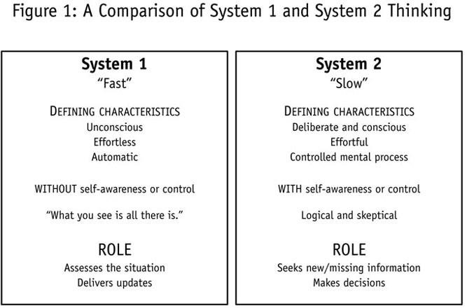
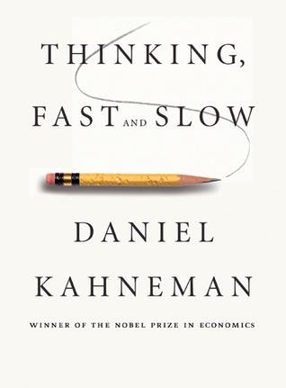
Human and Computational Thinking

Slide 14
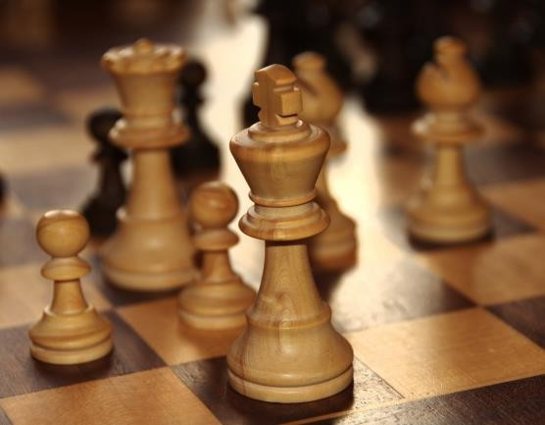
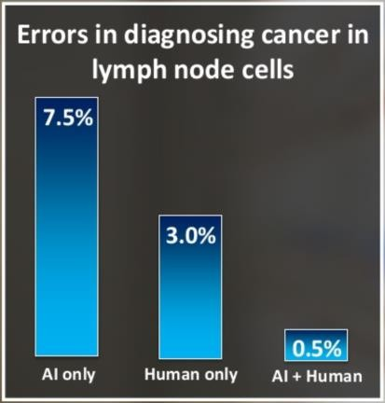





< <
“Weak human + machine + superior process was greater than a strong computer and, remarkably, greater than a strong human + machine with inferior process.”
Garry Kasparov

